Slide 1
2-1 Designing a Level
5CM503 Virtual Environment Development
Dr Patrick Merritt

Slide 2
Contents
Level Design 101

Slide 3
Level Design:- 101
And story writing 101!

Slide 4
Why am I learning this…
You may not be the one designing the levels in your game.
If you are in AAA studios, it’s most likely that someone will hand you a document and you will build the level from that.
In an indie studio, you probably will have to at least provide some input.
In either case you need to understand the document to be able to implement it.

Slide 5
The basics, what do you need to include.
As a minimum.
A level name.
A concept.
A starting point.
A description of the challenges presented within the level.
The rewards given to the player.
An endpoint.
The expected path/paths through the level.
A timeline showing major events within the level.

Slide 6
A level name
Fairly obvious and self-serving.
Should be unique and easily identify the level and its contents.
Should not be
Overly complicated.
Contain spoilers.

Slide 7
A concept
What is the concept for this level?
What does the player do here?
What is the theme?
Where do they go?
How do they get there?
And what do they do along the way?

Slide 8
Example:-
Jeremy and the mystery of the Old West!
Level Name:- Train Troubles!
Our hero Jeremy, must pursue the evil Sheriff Dave the Dastardly through the train, shooting bad guys and rescuing his girlfriend Linda. Jeremy must also crack the safe, and collect the map leading to the legendary McGuffin. Finally, Jeremy engages Dave in a duel on the roof of the train.

Slide 9
Example:-
Jeremy and the mystery of the Old West!
Level Name:- Train Troubles!
Our hero Jeremy, must pursue the evil Sheriff Dave the Dastardly through the train, shooting bad guys and rescuing his girlfriend Linda. Jeremy must also crack the safe, and collect the map leading to the legendary McGuffin. Finally, Jeremy engages Dave in a duel on the roof of the train.

Slide 10
Character profiles
May already exist in the GDD.
If not add them now.
Jeremey, Dave and Linda who are they?
Profile the baddies too!

Slide 11

Example:- Jeremey
NAME :- Jeremy the Flerb.
AGE :- 26.
GENDER :- Male.
TRAITS :- Honourable, Heroic, Brave
DESCRIPTION :- Jeremey is the hero of our story, a heroic gunslinger and excellent gunslinger. Sworn to bring down Dave the Dastardly.
RELASIONSHIPS :- Girlfriend Jenny.

Slide 12
Example:-
NAME :- SCOUT
AGE :- 20
GENDER :- Male
TRAITS :- Fast, Close Quarters, Melee
DESCRIPTION :-
RELASIONSHIPS :-

Slide 13
Rules
You may also want to set some rules that the character abides by.
Rules are never broken by the character, unless essential.
Jeremy never cheats.
Jeremy always is on the side of good.
Generally, once a rule is established in this way, you don’t change it without major character development.
If the character development occurs, create a second character for post change.
This can help keep your characters consistent!

Slide 14
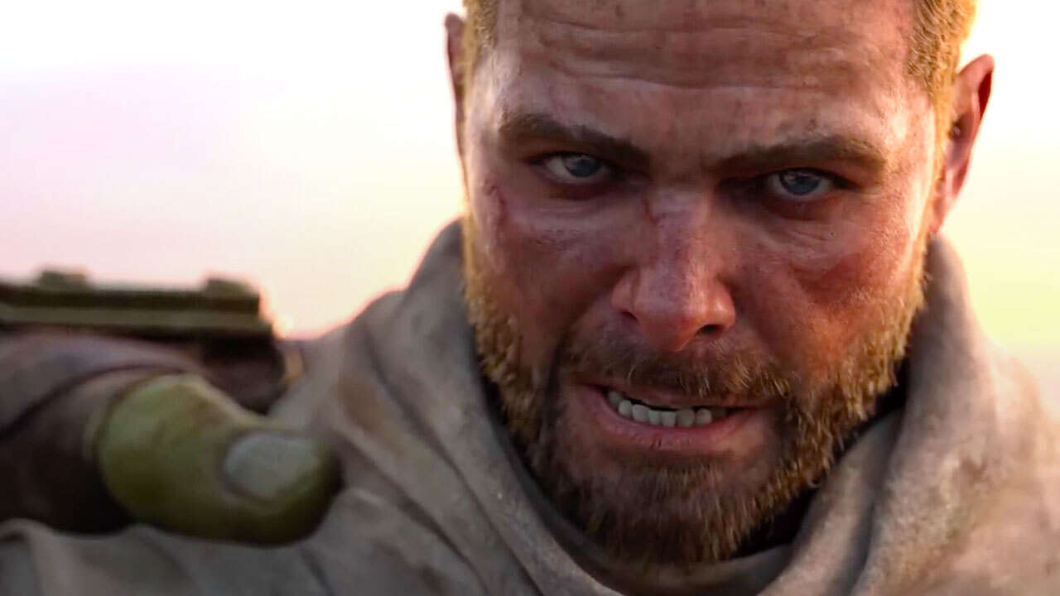

Slide 15
A starting point.
Describe the entry point to the level.
What happened immediately before this point?
What is your player feeling?
What are the immediate observable surroundings?
What information are you giving the player and how are you giving it to them?
How are you trying to make them feel?

Slide 16
Jeremy boards the train…
Having previously snuck into the warehouse belonging to Dave the Dastardly, and obtained his notebook of evil schemes, he awaits his nemesis’s arrival on the platform.
As our previous level was a stealth level we expect our players to be excited and anticipating a confrontation.
A cut scene plays, the train is not slowing down! Someone must have tipped off Dave that we were coming, but how?
Our hero leaps for the train at the last moment, a QTE plays to grab onto the back of the train.
On success, Jeremy lands in the guard carriage of the train. The guard confronts him intent on protecting his boss…
The player is ready for action!

Slide 17
Challenges
Same sort of pattern as the start and end sections but for the key moments of gameplay in the level...
Often accompanied by sketches of the imagined scene.
No you do not have to be any good at this!
Allow me to prove this!

Slide 18
Challenge one, Third class carriage
Jeremy enters a fairly standard railway carriage from the rear, having heard the kerfuffle from taking out the guard several members of Dave’s gang have taken position in the carriage and light Jeremy up as he enters the carriage.
Rewards,
Progression
Health
Ammo

Slide 19
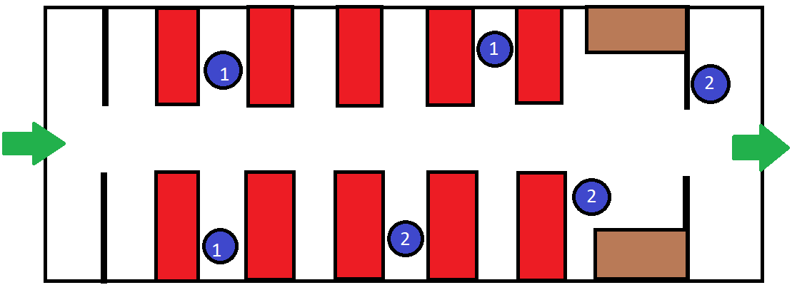
Challenge One, Third class carriage
Jeremy enters a fairly standard railway carriage from the rear, having heard the kerfuffle from taking out the guard several members of Dave’s gang have taken position in the carriage and light Jeremy up as he enters the carriage.
Rewards,
Progression
Health
Ammo

Slide 20
HOLD ON!
That looks crap!

Slide 21
HOLD ON!
That looks crap!
Yes, yes it does!
We are not trying to make it pretty, we are trying to express an idea.
Pretty is someone else’s job.
Information is key!

Slide 22
Everything here?

Slide 23
Missed the rewards.

Slide 24
Rewards…
List of key things given to the player in the level.
Does not include the mundane, You don’t need to specify every health and ammo pickup in excruciating detail.
But things like, the map to the McGuffin would qualify
No impact on the game but key to the story, we should not leave the level without it.
New tools
It is key to identify when and where we give the player new tools so we know their capabilities

Slide 25
An end point
How does this level end?
What happened immediately before this point?
What is your player feeling?
What are the immediate observable surroundings?
What information are you giving the player and how are you giving it to them?
How are you trying to make them feel?

Slide 26
A twist in the tale!
Having fought Dave the dastardly in a duel on top of the train, our hero has successfully disarmed Dave and is ready to turn him over to the law.
Huzzar! We win!

Slide 27
A twist in the tale!
Having fought Dave the dastardly in a duel on top of the train, our hero has successfully disarmed Dave and is ready to turn him over to the law.
Huzzar! We win!
But oh no it seems Linda is working for Dave! And bashes us over the head with a frying pan!
Betrayal!

Slide 28
A twist in the tale!
Having fought Dave the dastardly in a duel on top of the train, our hero has successfully disarmed Dave and is ready to turn him over to the law.
Huzzar! We win!
But oh no it seems Linda is working for Dave! And bashes us over the head with a frying pan!
Betrayal!
We are thrown from the train and the level fades to black as we are tossed over the side.
Suspense! REVENGE!
(don’t worry, we land in a haystack or something idk not writing that level)

Slide 29
A twist in the tale!
Having fought Dave the dastardly in a duel on top of the train, our hero has successfully disarmed Dave and is ready to turn him over to the law.
Huzzar! We win!
But oh no it seems Linda is working for Dave! And bashes us over the head with a frying pan!
Betrayal!
We are thrown from the train and the level fades to black as we are tossed over the side.
Suspense! REVENGE!
(don’t worry, we land in a haystack or something idk not writing that level)

Slide 30
Planning the path
Connect the dots,
How to get from the start to the finish via all mandatory activities.
Add side activities and alternate paths as necessary
I normally do this as I do the block out.
(we will look at this next week)

Slide 31
Start
1
C1
2
C2
3
Rescue Linda
9
4
8
7
6
5
4
3
2
1
C3
5
C4
6
Crack safe (McGuffin)
7
Boss Fight
8
End
9

Slide 32
Pacing…
Work out the pace you wish to set in your game and see if the plan you have works for that.
Boss Fight
Pacing
C4
C2
C3
Crack safe (McGuffin)
C1
Rescue Linda
Start
Time

Slide 33
Pacing…
Work out the pace you wish to set in your game and see if the plan you have works for that.
Boss Fight
Pacing
C4
C2
C3
Crack safe (McGuffin)
C1
Rescue Linda
Start
Time

Slide 34
Pacing…
Work out the pace you wish to set in your game and see if the plan you have works for that.
Boss Fight
C4
Pacing
Crack safe (McGuffin)
C3
C2
Rescue Linda
C1
Start
Time

Slide 35
Homework!
Plan a level for your game.
If struggling take a level from an existing game and create a plan for that.
I would anticipate your level will need 2 levels MAX.
Most will only need one.
This document is needed for the CW1 assignment!
Can be done much more professionally than my slides would make it appear!
http://www.ewright.ca/uncharted-storm-the-tower.html <-- Clicky!

